Slide 1


ITE-1008_B2_11
Submitted To-
Prof. Jayakumar Sadhasivam
Submitted By-
Arnab Poddar (19BIT0097)
Shresth Raj (19BIT0120)
Nikhar Gangwar (19BIT0083)
Manav Popli (19BIT0103)

Slide 2
ABSTRACT
Now-a-days we all are living in a rush either in personal or professional life. And due to this current situation of COVID19 our health and immunity should be at the utmost importance. Inspite of this we barely give enough time for our diet and nutrition.
To provide a convenient solution of this problem we have made a web application called Meal Wagon, where one can set his fitness goals and diet preferences and the website will guide him through his daily meal plans and calorie intakes, helping him reach his target fitness state and maintain an ideal BMI(Body Mass Index).

Slide 3
INTRODUCTION
Meal-Wagon is a vision through which health needs of eating good nutritious but tasty food is met to whomever it reaches to. This web app is a great source of keeping track of what to eat and at what time. This web app helps in generating a full day meal for the user which includes Breakfast, Lunch, Dinner and also keeps a track of how much nutrients has been taken by the user and how much is left for the day.
The user can also search the meals of his choice and can see the recipe of the meals .Also if the user does not like the meals generated ,he /she can generate a new meal.

Slide 4
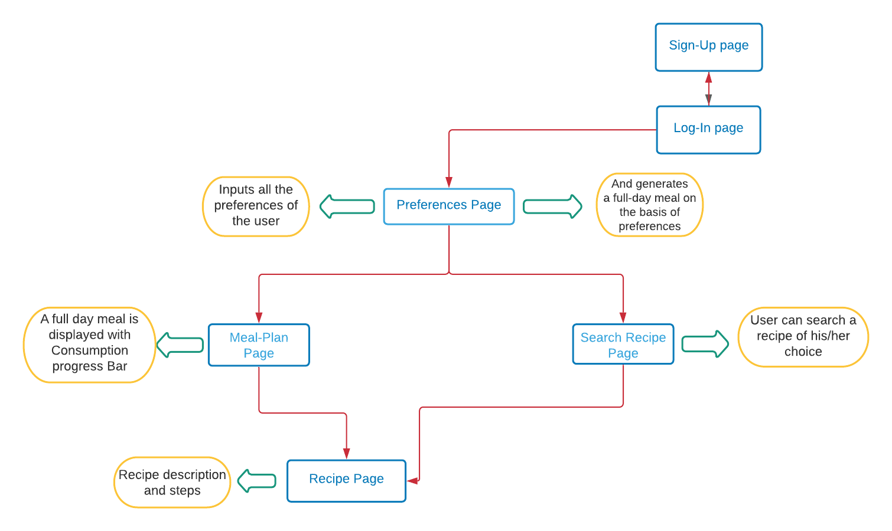
Process-Flow Diagram

Slide 5
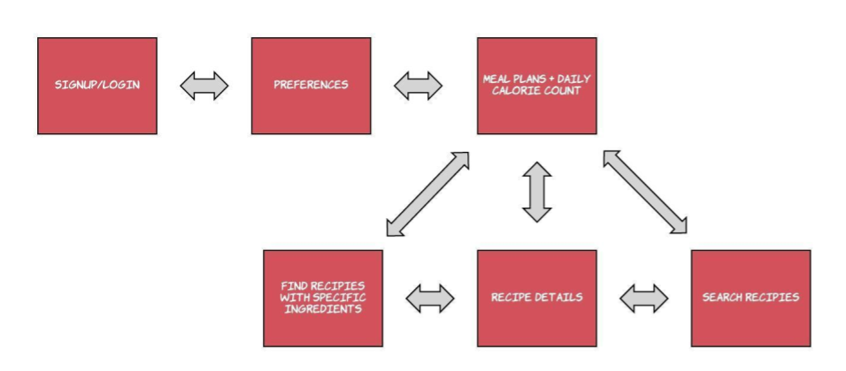
Website Architecture

Slide 6


Modules Used:
Front-end Stack:
HTML
CSS
Javascript
Back-end Stack
PHP
Database
MySQL
API
Spoonacular API
https://rapidapi.com/spoonacular/api/recipe-food-nutrition

Slide 7
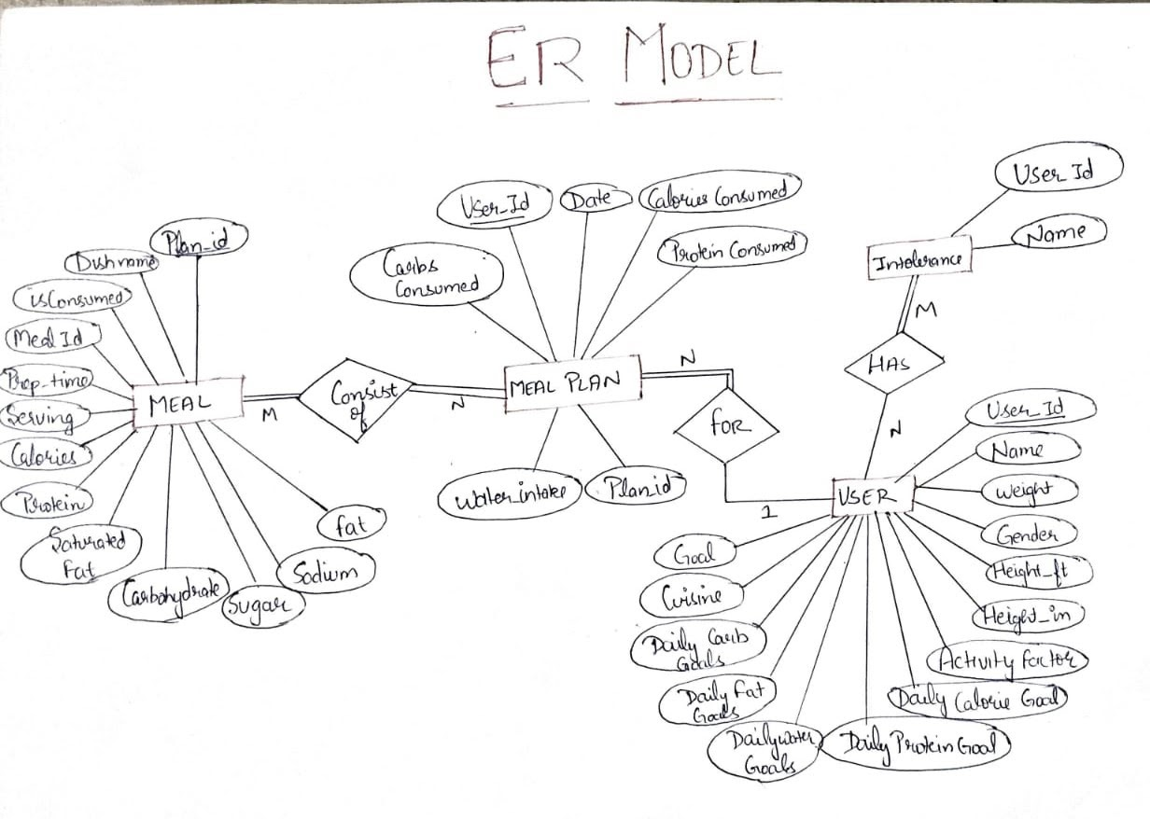
E-R Model

Slide 8
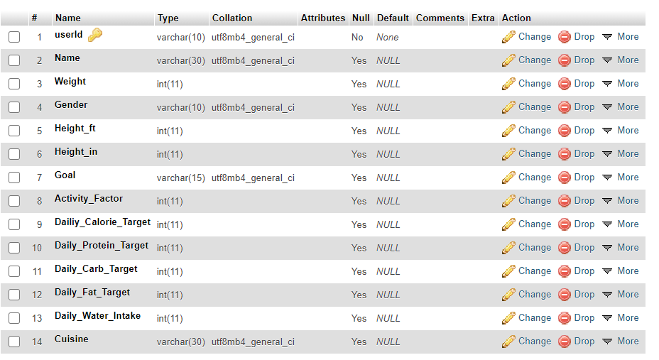
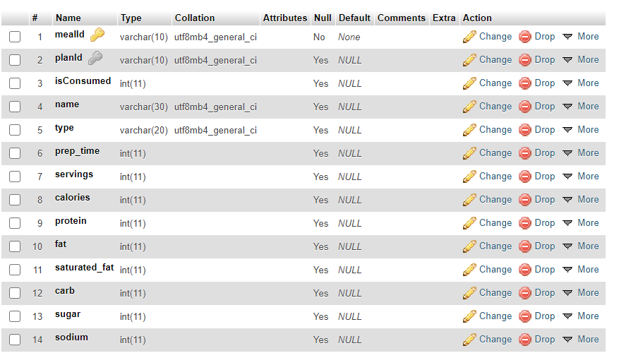
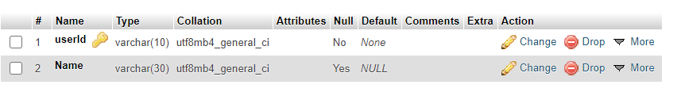
User Schema
Meal Schema
Intolerance Schema

Slide 9
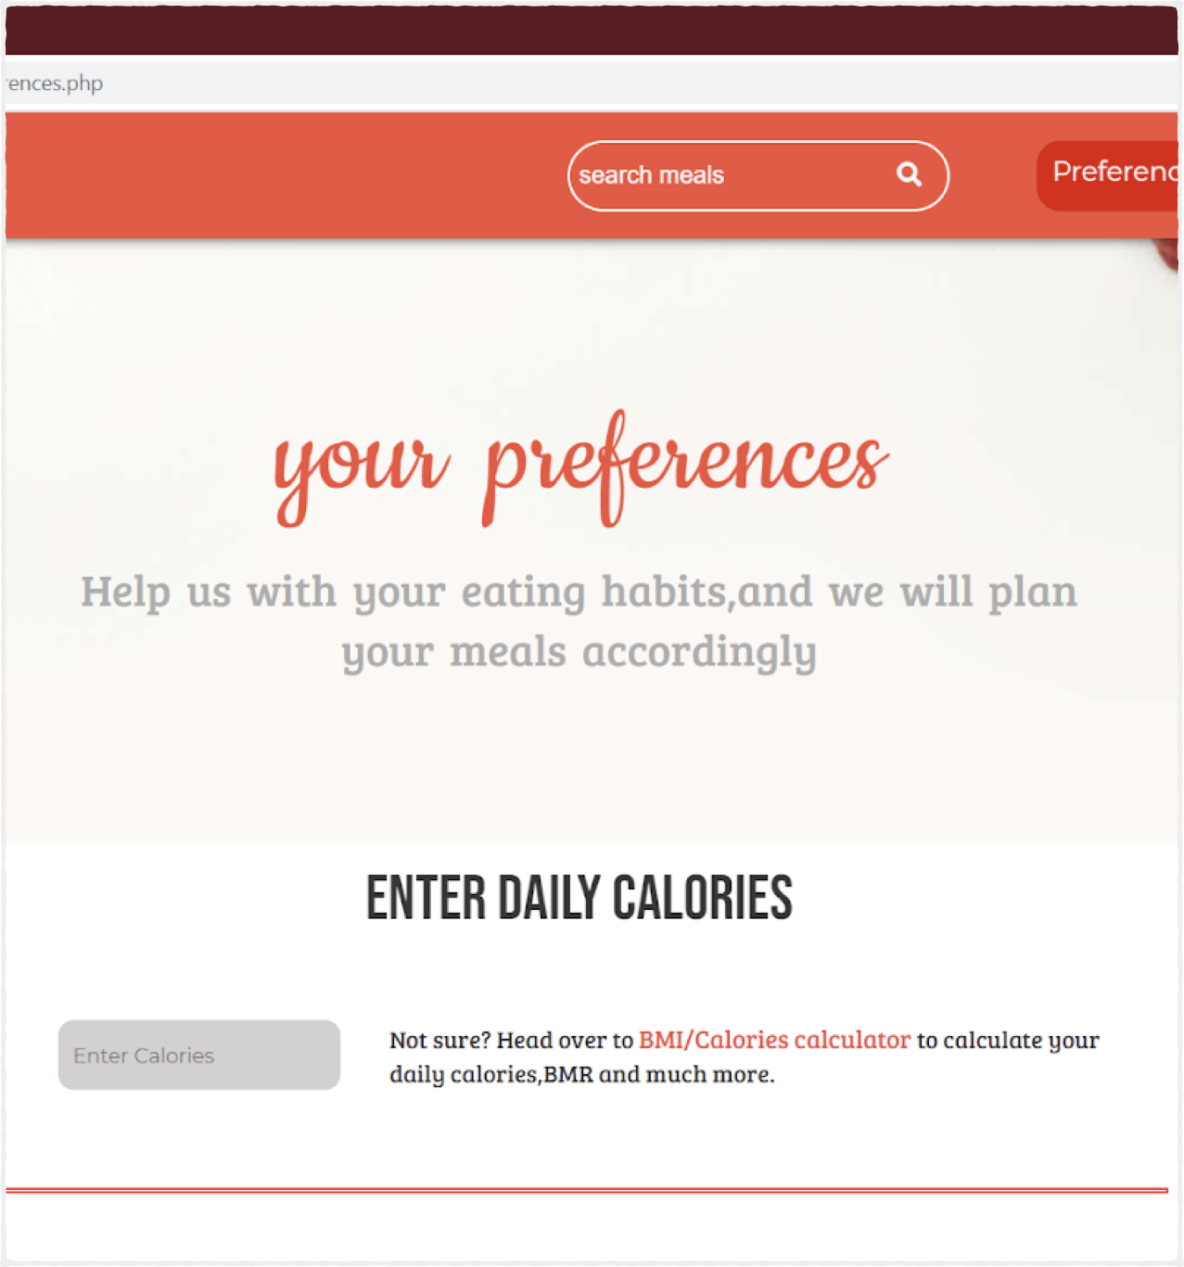
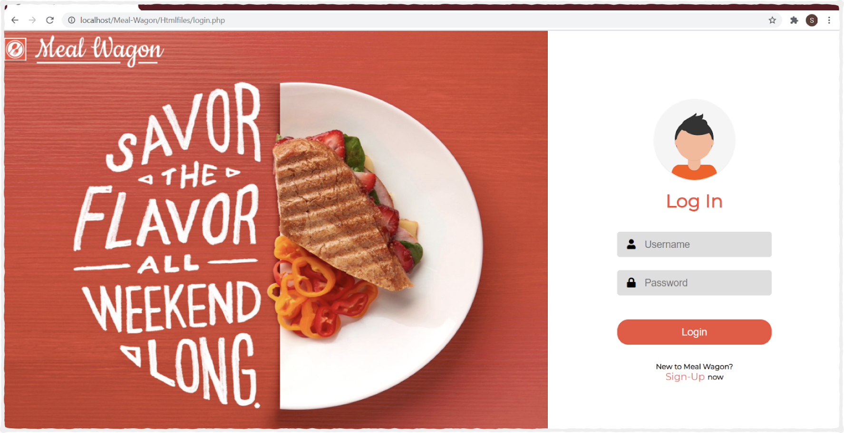
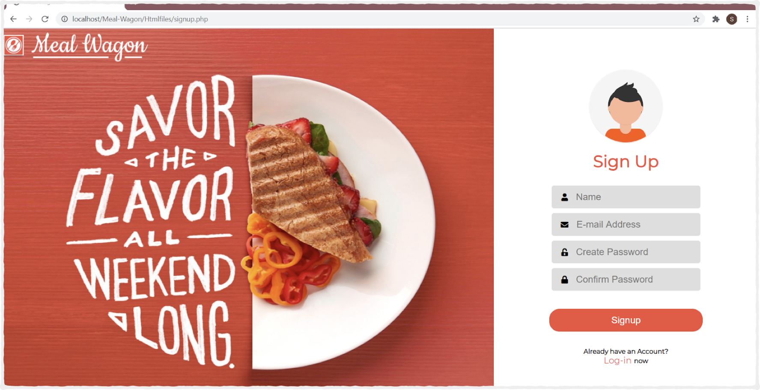

Slide 10
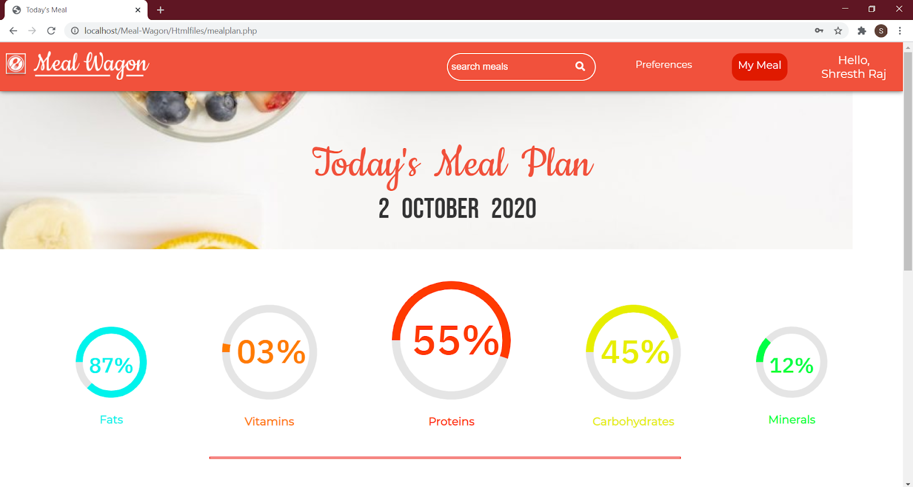

Slide 11
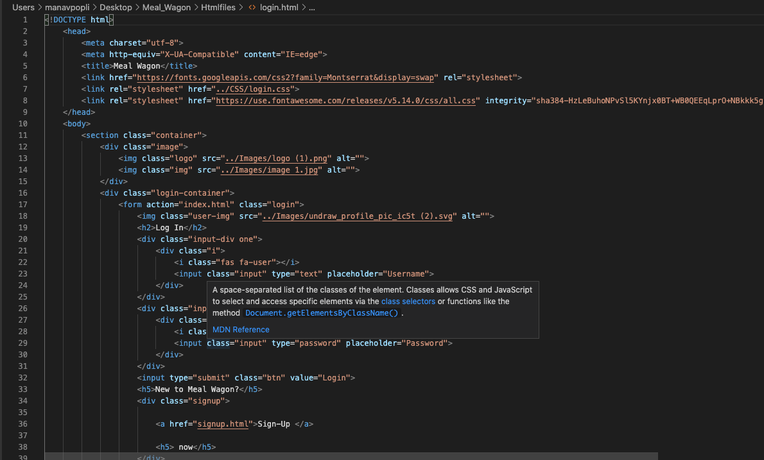
Source Code-

Slide 12
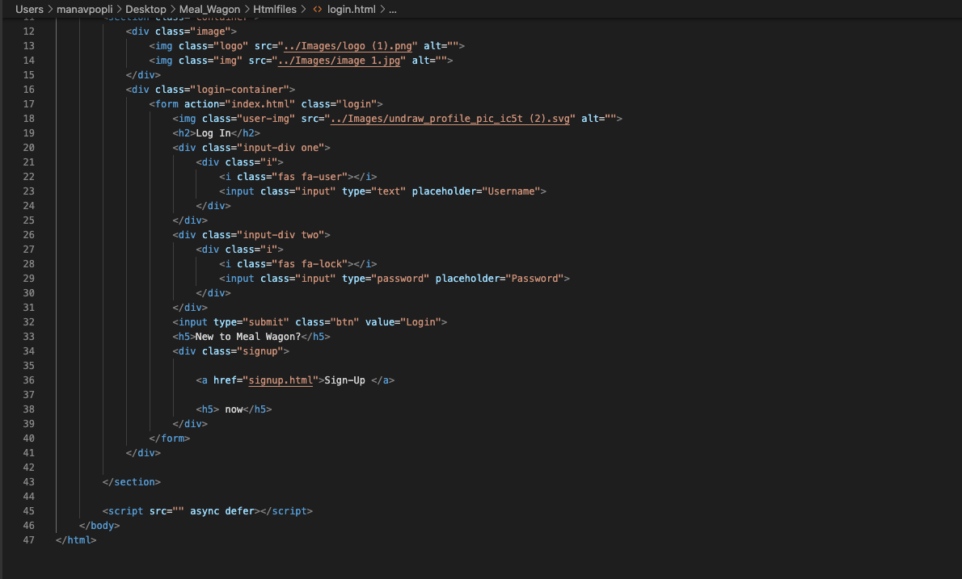

Slide 13
Conclusion:
So we would like to conclude that, the problems regarding nutrition of people according to their preferred calories intake can be solved through this website. Moreover, the quest to search for different recipes along with their ingredients, steps, equipment and most important with all its nutrients can be easily assessed by this website. The personal user-account will monitor all your daily updates regarding nutrition with full privacy. This website will play an important role in making people fit and healthy

Slide 14

References:
https://rapidapi.com/spoonacular/api/recipe-food-nutrition
www.w3shools.com
www.php.net

